Slide 1
WEATHER DATA ANALYSIS USING HADOOP ECOSYSTEM
T. Panya Sadhika - 2320030138
G. Jaswitha- 2320030216
Srivarsh- 2320039506

Slide 2
OVERVIEW
ABSTRACT
INTRODUCTION
EXISTING SYSTEM
PROPOSED SYSTEM
OBJECTIVES
LITERATURE SURVEY
SYSTEM ARCHITECTURE
ACTIVITY DIAGRAM
MODULE DESIGN

Slide 3
ABSTRACT
Weather data is generated continuously from a wide range of sources such as satellites, radar systems, weather stations, and Internet of Things (IoT) sensors. These sources collect important environmental parameters including temperature, humidity, rainfall, atmospheric pressure, and wind speed. Because these systems operate continuously and cover large geographic regions, they produce massive volumes of data every day. The collected data can be both structured (such as tabular sensor readings) and unstructured (such as satellite images or radar signals). Managing and analyzing such large and rapidly growing datasets using traditional database systems becomes extremely challenging. Conventional relational databases are not designed to handle big data volumes efficiently, especially when the data grows at high speed and requires large-scale processing. As a result, there is a need for advanced technologies that can store, process, and analyze large datasets in a distributed and scalable manner.
This project addresses these challenges by using the Hadoop ecosystem, which is a powerful framework designed for big data storage and processing. Apache Hadoop provides a distributed computing environment that allows large datasets to be stored and processed across multiple machines working together as a cluster. Instead of storing all the data in a single system, Hadoop divides the data into smaller blocks and distributes them across several nodes in the cluster. This approach improves both storage capacity and processing efficiency.
For storing weather data, the system uses Apache HDFS. HDFS is designed to store large files by splitting them into blocks and replicating them across multiple nodes to ensure data reliability and fault tolerance. If one node fails, the data can still be accessed from another node, which makes the system highly reliable.

Slide 4
INTRODUCTION
Weather data is continuously generated from a variety of sources, including satellites, radar systems, automated weather stations, and an increasing number of IoT sensors. These sources produce enormous volumes of data in both structured formats, such as numerical readings of temperature and humidity, and unstructured formats, like satellite images and radar scans. The continuous influx of such high-velocity data presents significant challenges for traditional database systems, which are often unable to efficiently store, manage, and process these large-scale datasets in real time.
To address these challenges, the Apache Hadoop ecosystem offers a robust solution for Big Data applications by providing distributed storage and parallel processing capabilities. Hadoop’s HDFS (Hadoop Distributed File System) allows data to be stored across multiple nodes, ensuring fault tolerance, scalability, and high availability. Processing frameworks such as Hadoop MapReduce enable parallel computation on large datasets, while Apache Spark allows in-memory processing for faster analytics. Additionally, Apache Hive provides an SQL-like interface to query and analyze data, making it easier for researchers and analysts to extract meaningful insights from complex weather datasets.
This project leverages these technologies to perform comprehensive weather data analysis. By examining parameters such as temperature, rainfall, humidity, wind speed, and atmospheric pressure, the system can identify climate trends, seasonal patterns, and extreme weather events. Such analysis not only enhances the accuracy of weather forecasting but also supports data-driven decision-making in agriculture, disaster management, urban planning, and other sectors affected by climatic conditions. Ultimately, integrating Big Data technologies with meteorological data enables more informed, timely, and strategic responses to the challenges posed by a changing climate.

Slide 5
LITERATURE SURVEY
Paper Link | Author | Future Directions | Drawbacks
https://www.ijert.org/big-data-in-weather-forecasting?utm_source=chatgpt.com | Vaishnavi P.N. et al., 2020 | Integrate real-time frameworks like Spark/Kafka | Focus on MapReduce only; slow for real-time
https://link.springer.com/chapter/10.1007/978-3-030-41593-8_13 | Hussein et al., AFRICOMM 2019 | Add advanced climate analytics models | Limited to satellite data classification
https://www.mdpi.com/2073-4433/11/8/870?utm_source=chatgpt.com | Wei & Chou, MDPI 2020 | Optimize distributed processing pipelines | Heavy computation for machine learning

Slide 6
LITERATURE SURVEY
Paper Link | Author | Future Directions | Drawbacks
https://ieeexplore.ieee.org/document/8103164 | IEEE Authors (2017) | Combine with Spark Streaming & machine learning | MapReduce focus only; slow for realtime processing
https://www.sciencedirect.com/science/article/pii/S1877050920304962 | ScienceDirect Authors (2020) | Use hybrid engines and indexing for fast queries | Limited to batch analysis; not optimized for mixed workloads
https://www.mdpi.com/2073-4441/12/3/776 | MDPI Authors (2020) | Extend with Hive + ML models for pattern discovery | Focuses more on forecasting; less deep analytics

Slide 7
EXISTING SYSTEM
“In the existing system, weather data is usually stored in traditional relational databases and processed using conventional data processing techniques.”
Limitations:
Limited scalability
Slow performance for large datasets
High maintenance cost
Inefficient processing for big data
“These limitations make it difficult to analyze weather data efficiently.”

Slide 8
PROPOSED SYSTEM
“Our proposed system uses the Hadoop ecosystem to overcome the limitations of the existing system.”
The proposed system:
Stores weather data in distributed storage
Processes large datasets using parallel processing
Uses query tools for data analysis
Advantages:
High scalability
Faster processing
Fault tolerance
Cost-effective infrastructure

Slide 9
OBJECTIVES
“The main objectives of our project are:”
To store large-scale weather datasets efficiently
To process weather data using distributed computing
To analyze climate parameters such as temperature and rainfall
To identify patterns and trends in weather data
To improve efficiency and scalability of weather data analysis

Slide 10
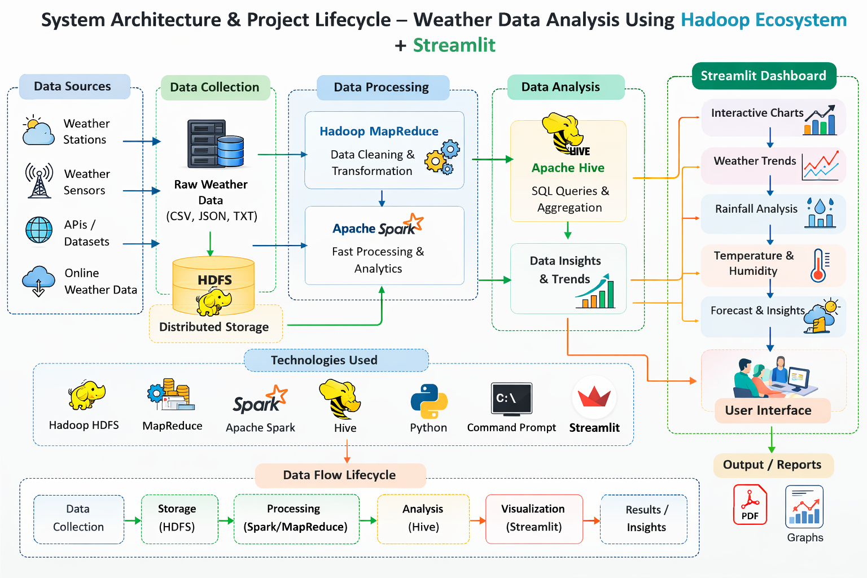
SYSTEM ARCHITECTURE

Slide 11
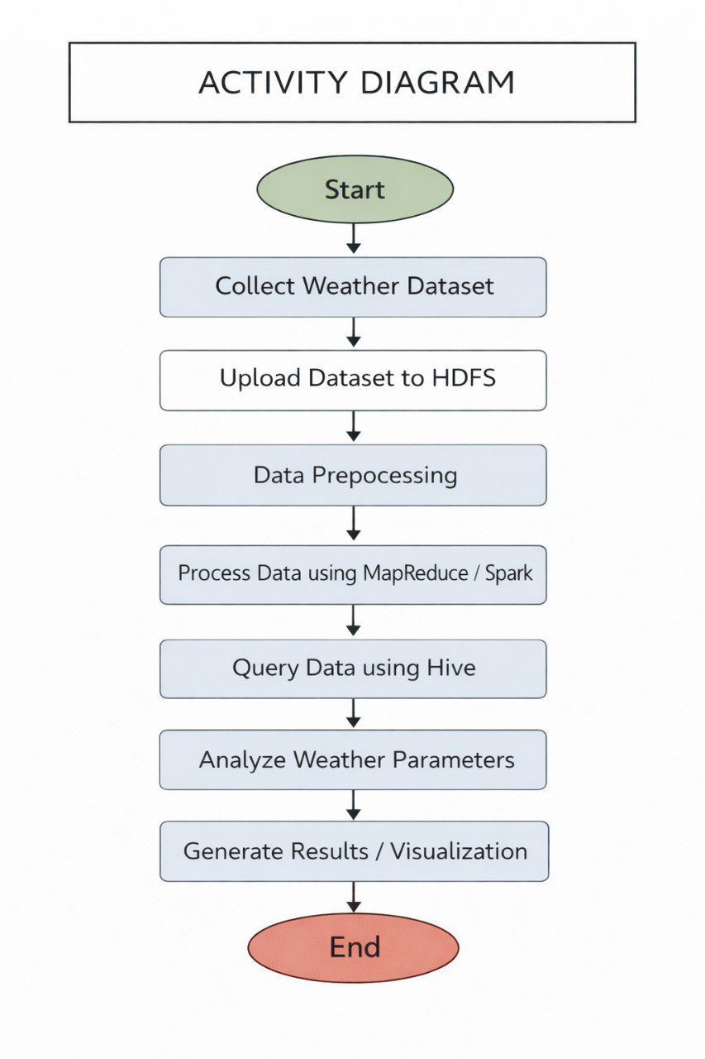
ACTIVITY DIAGRAM

Slide 12
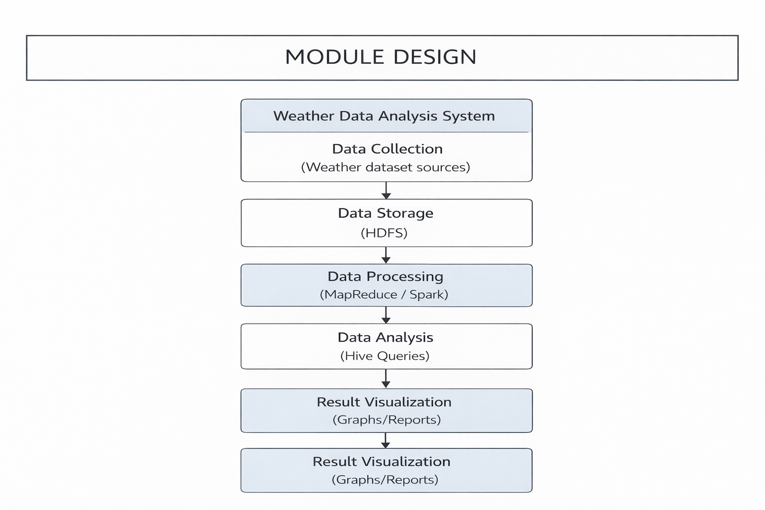
MODULE DESIGN

Slide 13
Thank You

